Slide 1
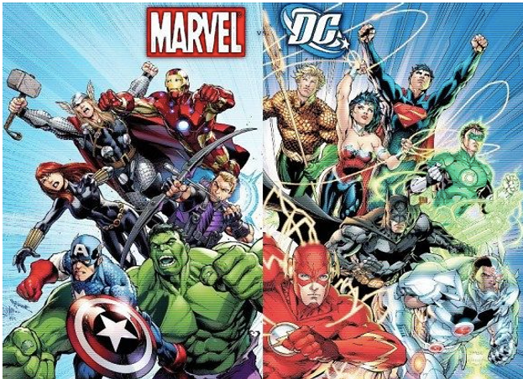
Marvel vs DC Universe
Project 1
Nate Savage, Frenci De la Cruz, Drew Bollinger, Nikki Alfrey
Image Credit: https://www.clarendonhousebooks.com/single-post/why-dc-can-never-hope-to-emulate-marvel-in-the-cinema

Slide 2
Does budget determine the box office gross worldwide profits? Does franchise have a defining factor in gross worldwide profits?
Drew’s visualizations

Slide 3
Does the year the film was released determine a better or worse Rotten Tomato score? Does franchise affect the Rotten tomato score?
Nate’s visualizations

Slide 4
Does the length of the film(in minutes) affect the Rotten Tomato rating?
Frenci’s visualizations

Slide 5
Does the main character lead (Male or Female) affect the rating or is the budget higher/lower for male/female lead films?
Nikki’s visualizations

Slide 6
Citations
https://www.kaggle.com/datasets/willianoliveiragibin/marvel-vs-dc
https://www.kaggle.com/datasets/jcraggy/marvel-vs-dc-imdb-rotten-tomatoes
https://www.kaggle.com/datasets/darrylljk/marvel-cinematic-universe-films-box-office
https://www.kaggle.com/datasets/davidgdong/marvel-cinematic-universe-box-office-dataset
https://www.kaggle.com/datasets/mdtoomey/box-office-of-dc-and-marvel-superhero-movies
https://www.kaggle.com/code/cliomaciel/eda-dc-marvel/notebook

